Slide 1
Study
JS
5Weeks

Slide 2
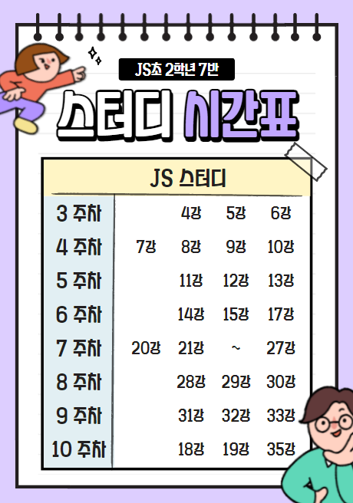

Slide 3
6Weeks
14,15,17

Slide 4









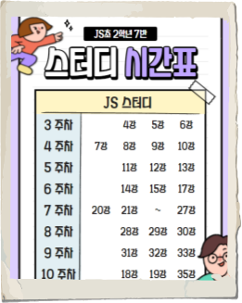



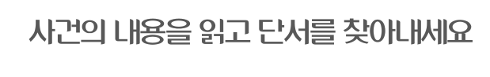


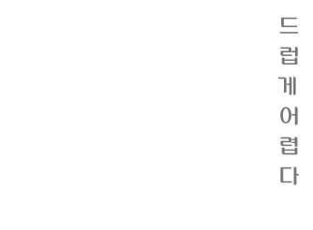


Slide 5




Slide 6
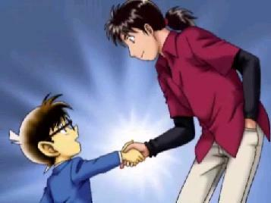

Slide 7
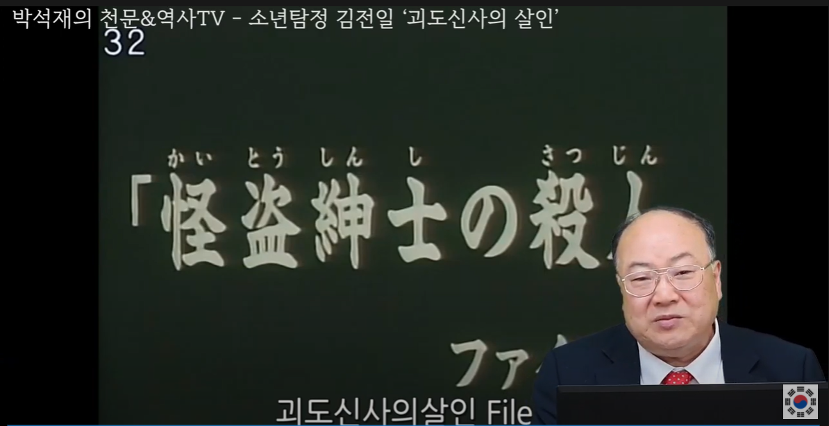
https://www.youtube.com/watch?v=wLHZ6dsVtm0

Slide 8
카르네아데스의 판자

Slide 9
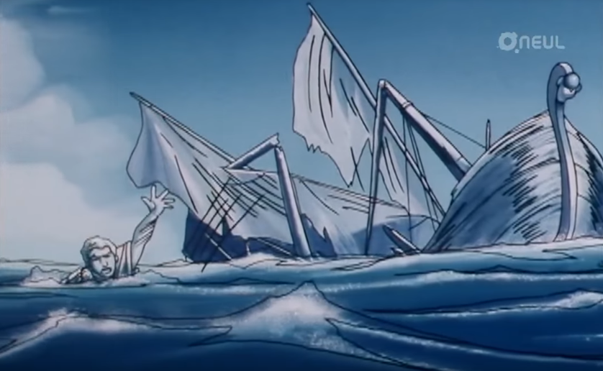

Slide 10
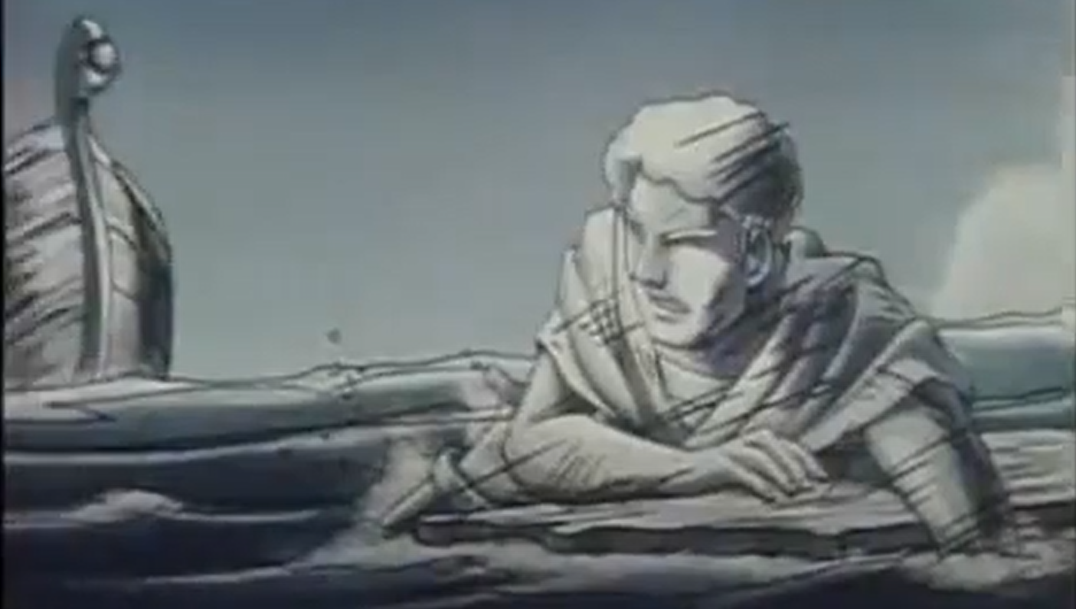

Slide 11
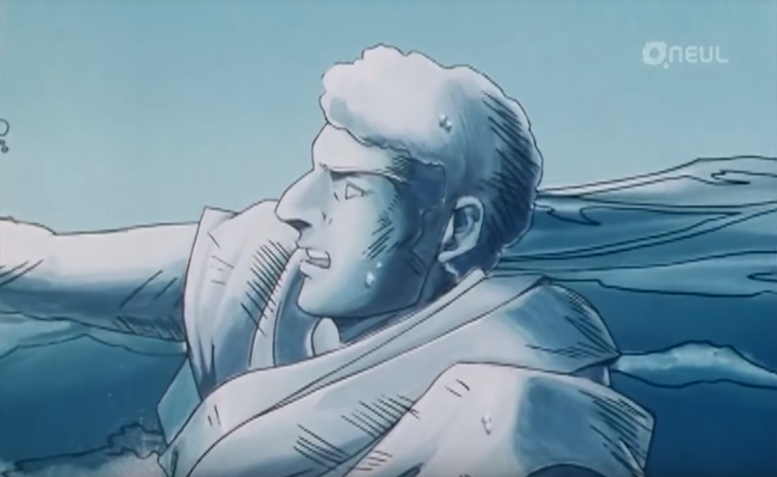

Slide 12
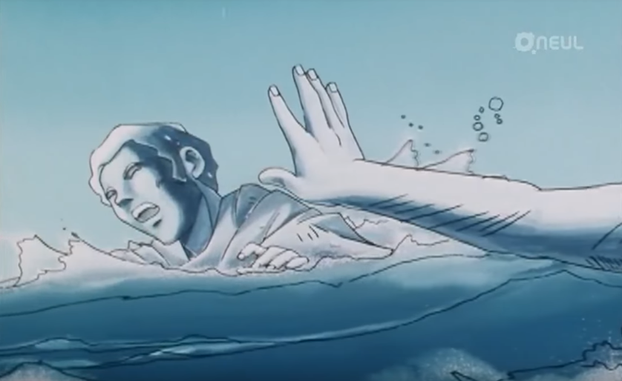

Slide 13
딜레마

Slide 14
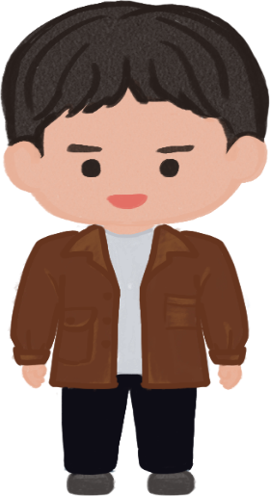
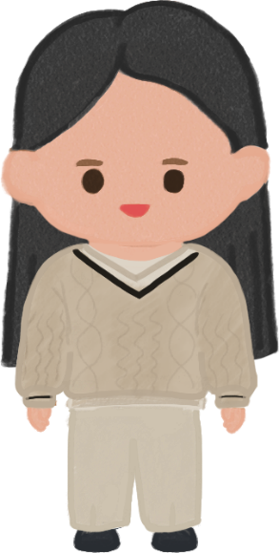

!
!

Slide 16
Scope

Slide 18
암묵적 전역 변수

Slide 19
strict mode

Slide 20
Prototype

Slide 21
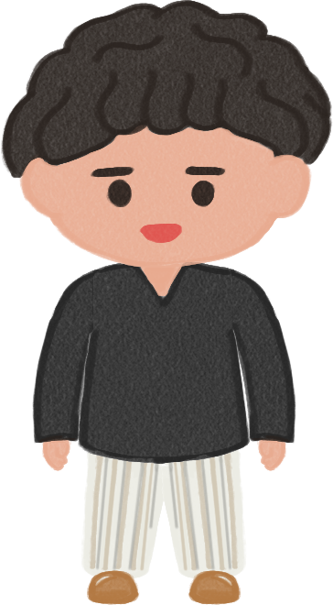
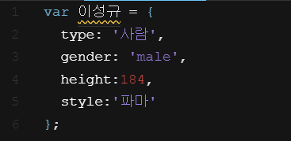

Slide 22


Slide 23
Blood

Slide 24
Prototype Chain

Slide 25
95%

Slide 26
https://www.youtube.com/watch?v=wUgmzvExL_E

Slide 27
This

Slide 28


Slide 29
Someone Like U

Slide 30
Never mind I’ll find someone like you

Slide 31
“Don’t’ for get me” I beg,

Slide 32
“I’ll remember”
U said

Slide 33
But Sometimes
It hurts
instead

Slide 34
Sometimes
It lasts in
love

Slide 35
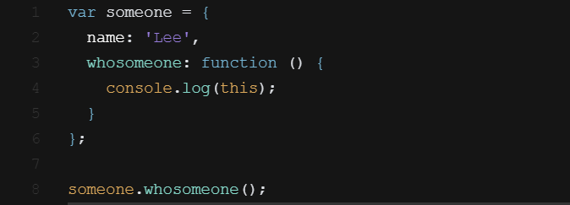

Slide 36
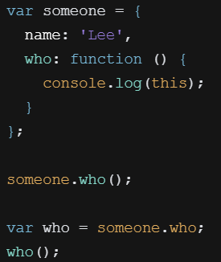
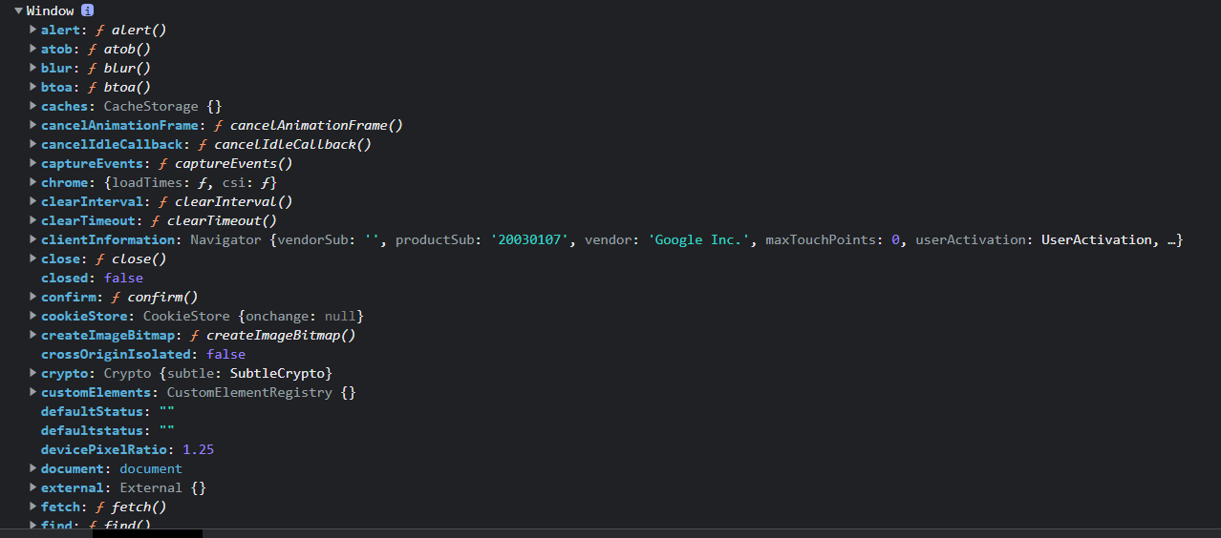

Slide 37
This === 호출한놈

Slide 38
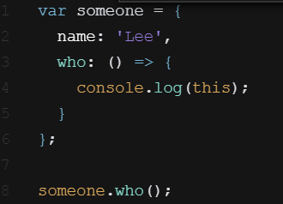
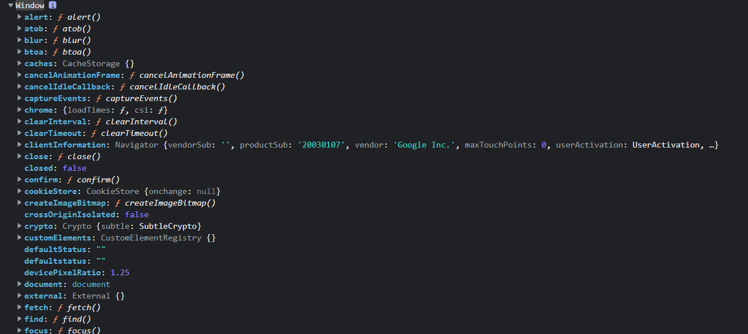

Slide 39
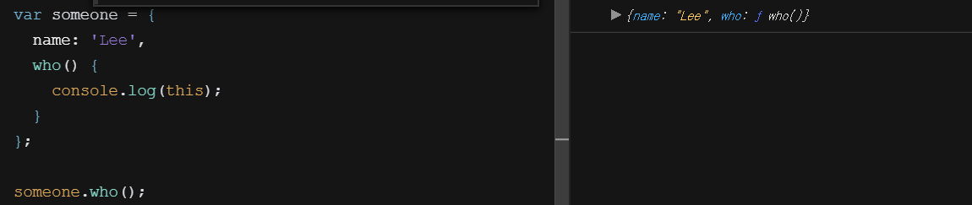

Slide 40
Finish

